Slide 1
DIAS: Decentralized Internet Applications and Services
Final Project Presentation
3/13/14
Adriana Flores
Clayton Shepard
Ellis Giles
Haiuhua Shen
Yanda Lu

Slide 2
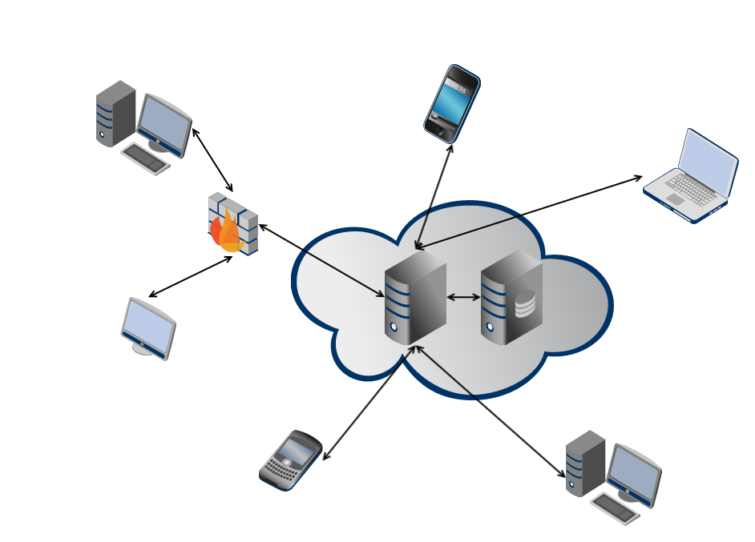
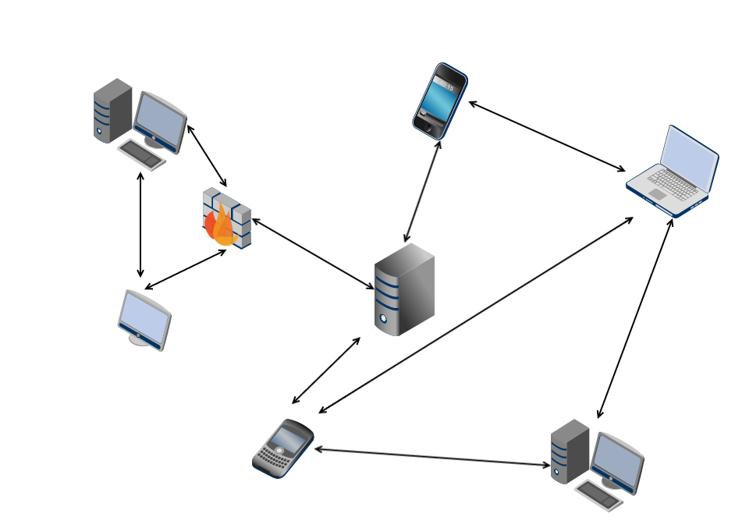
Problem
Centralized Architecture
Single point of failure
✗ Privacy
✗ Security
✗ Energy efficiency
Decentralized Architecture
Robust to failure
Reclaim personal data
Power efficiency
Notes:
. Use 2 minutes to remind audience the problem/question that you want to address
====
centralized servers have many drawbacks, ranging from
privacy, security, and fault-tolerance, to even energy-efficiency
and control over data
Power-hungry data centers
According to Google their global data center operation electrical power ranges between 500 and 681 megawatts.
Decentralize the current server-client mode paradigm in the current Internet

Slide 3
DIAS: Decentralized Internet Applications and Services
Goal:
Decentralize the current server-client model
Replace servers with point to point communication for personal communication and services
Email, Web Pages, Social Networking, Chat, VoIP
Benefits:
Security, Privacy, Resilience, Cost, and Power
Challenges:
Redundancy, Uptime, Failover, Battery Management
Notes:
. Use 2 minutes to remind audience the problem/question that you want to address
=========
How do we ensure reachability?
What happens if the cellphone loses connectivity?
What if it is lost/broken/stolen?
We need to find novel methods to ensure redundancy for both uptime and data.
Redundancy
Uptime
Data

Slide 4
DIAS Architecture
Ellis
Notes:
. Use 10 minutes to explain in detail your solution or approach to address the problem/question

Slide 5
DIAS Implemented Services
Web – Nano and iJetty
Email - JES
SSH
Proxy
P2P

Slide 6
DIAS: Web Server
Yanda
Ellis

Slide 7
DIAS: Email Server
Adriana

Slide 8
DIAS: SSH Server
Clay

Slide 9
DIAS: Proxy Server
Ellis

Slide 10
DIAS: Peer to Peer
Haihua
Ellis

Slide 11
DIAS: Android APP
MAIN TAB…
Ellis & adriana

Slide 12
DIAS DEMO
Download of APP in this website:
Set your device name:

Slide 13
DIAS DEMO
Try Web Service:
Try SSH Service

Slide 14
DIAS DEMO
Failover
Recovery

Slide 15
Summary
Take-home points
Lessons learned
Future Directions
Conclusions
Notes:
. Use 3 minutes to summarize take-home points, discuss lessons learned, future directions, and conclusions

